Slide 1
FACILITY CASE STUDY
Padmini VNA Mechatronics Ltd.
PVNA
Gurugram, Haryana, India

Slide 2
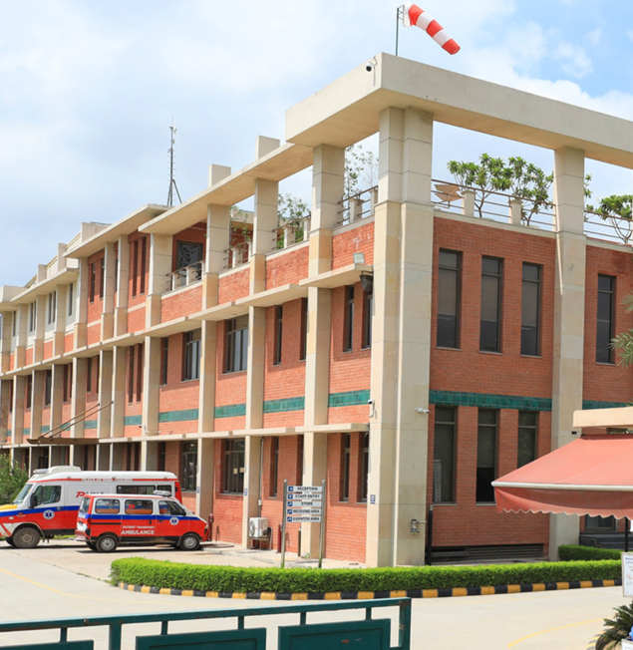
Padmini VNA
Mechatronics Ltd.
PVNA
Certification level: True Platinum
Diversion rate upon certification: 97.4%
Facility location: Gurugram, Haryana, India
Type of facility: Manufacturing Facility
Notes:
Include a photo of your facility if available. If a photo is unavailable or too granular, the photo box can be deleted.

Slide 3
Why zero waste?
PVNA's motivations for pursuing TRUE certification
Environmental Stewardship
Circular Economy Leadership
Regulatory Compliance
Committed to minimizing ecological impact under the Made in India initiative, reducing landfill dependency.
Converting waste into resources on-campus with the OWC, upcycling pallets, and sourcing reusable packaging from vendors.
Meeting all HSPCB mandates including Solid Waste Management Rules, PWM Rules 2016, E-Waste Rules 2022, and Hazardous & Other Wastes Rules 2024.
Community & Employee Engagement
Innovation & Continuous Improvement
Measurable Impact
Fostering a culture of sustainability through R&R programs, community clean-up drives, food donations to Local NGOs, and donating dog shelters for Blessing Foundation.
Driving innovative practices food portioning dashboards, upcycled pallet furniture, bamboo tissue procurement.
440+ tonnes of waste diverted annually. Contamination held at just 2–2.5%, far below the 10% ceiling, demonstrating operational excellence in waste management.

Slide 4
Biggest wins
Key achievements from PVNA's zero waste journey
97.4%
4,40,237 kg
2–2.5%
Waste Diversion Rate
Annual Waste Diverted
Contamination Rate
>90% diversion achieved across 12-month reporting period
100% of material streams diverted via highest & best-use pathways
Well below the 10% threshold — driven by rigorous employee training
On-Site OWC
Zero Plastic
Dog Shelters
Closed-Loop Composting
Packaging Transformation
Upcycling & Community Giving
Wet waste → compost → campus kitchen garden; zero third-party disposal
Foam packaging replaced with reusable rigid PET trays from vendors
Wooden pallets upcycled into dog shelters donated to Blessing Foundation

Slide 5
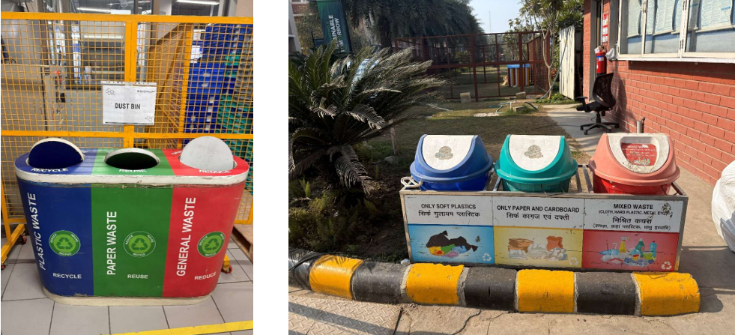
Redesign
C1 – Right size collection containers and service levels
Three-in-one waste bins (Paper/Plastic/General) placed across campus based on observed waste volumes. Food waste bins at plate drop-off zones. Periodic reviews via internal assessments and annual audits ensure containers are correctly sized and pick-up schedules are optimized.
Three in one waste bins

Slide 6
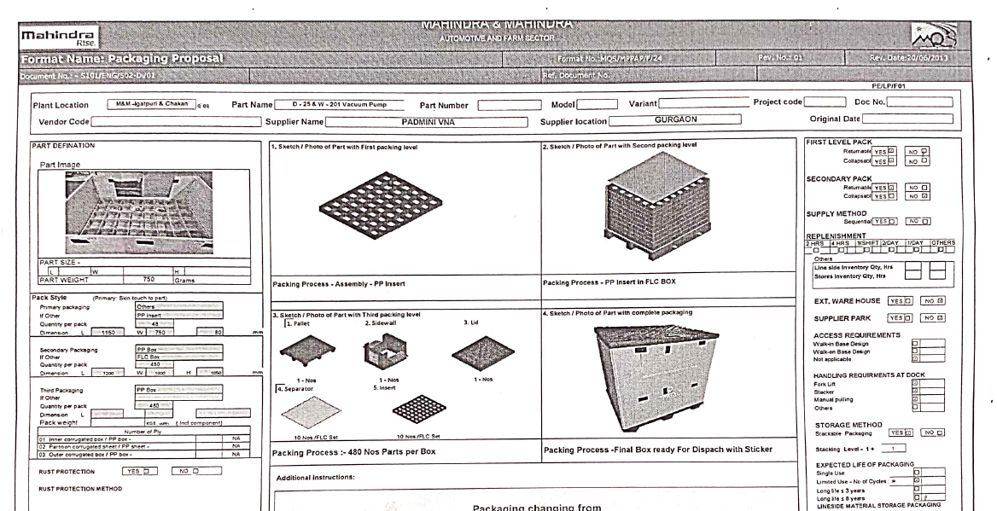
Redesign
C4 – Complete review of supply chain
End-to-end supply chain review identified Mahindra as the highest-volume supplier. Targeted engagement ensured compliance with PVNA's sustainable procurement guidelines and reusable packaging requirements under the Zero Plastic Waste Policy. Continuous monitoring is in place.
Reusable Packaging specifications

Slide 7
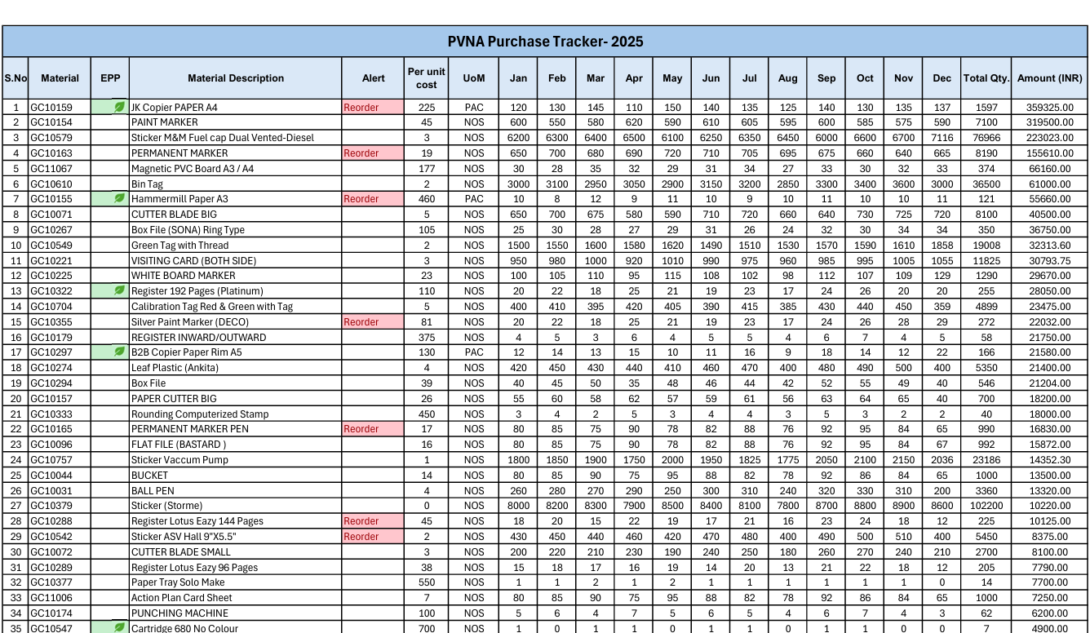
Reduce
C2 – Implement tracking programs to eliminate waste before it occurs
Monthly purchase order tracking via spreadsheets. Before procuring new materials, the purchase department reviews current inventory. This prevents unnecessary purchases and identifies upstream waste reduction opportunities.
Purchase Order tracker

Slide 8
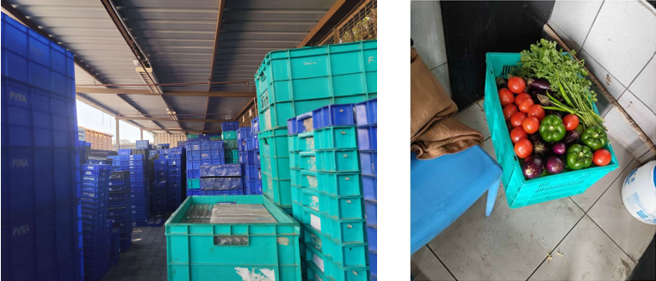
Reduce
C3 – Adopt a goal to reduce the overall size/amount of product packaging
Kitchen supplies delivered in reusable vendor crates instead of single-use packaging. Vendors retrieve and reuse crates for subsequent deliveries, closing the loop on inbound packaging.
Reusable vendor crates

Slide 9
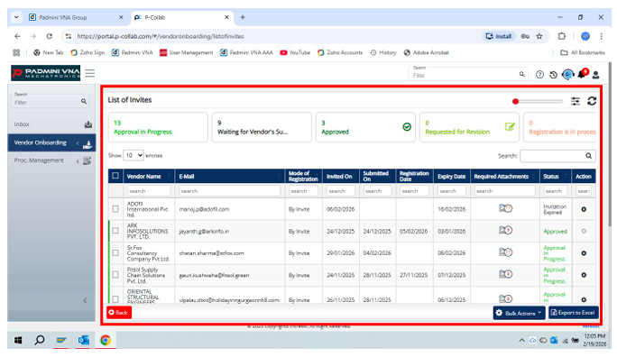
Reduce
C4 – Go paperless for at least one major office function
Vendor onboarding digitalized via online portal Document submission, verification, approvals, and record management are all electronic — eliminating paper-based forms. The initiative focuses on shifting traditional paper-based documentation and communication systems to a fully digital platform, supporting the facility’s sustainability and waste reduction objectives.
Digital vendor onboarding dashboard used to manage vendor registration, approvals, and documentation through an online platform, eliminating the need for printed forms and manual records.

Slide 10
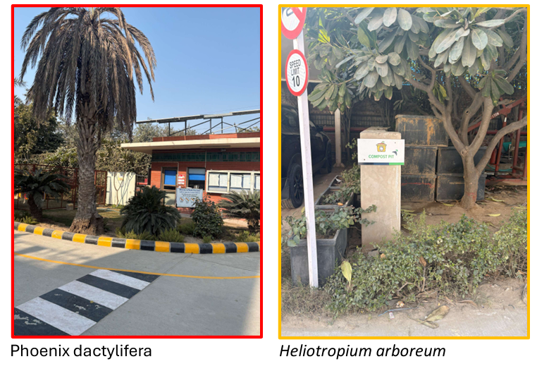
Reduce
C7 – Reduce yard trimming waste through native landscaping or xeriscaping
Native/indigenous plants selected across the campus — well-suited to local climate and soil, requiring minimal trimming, water, and maintenance, significantly reducing yard trimming waste.
Native vegetation planted on site

Slide 11
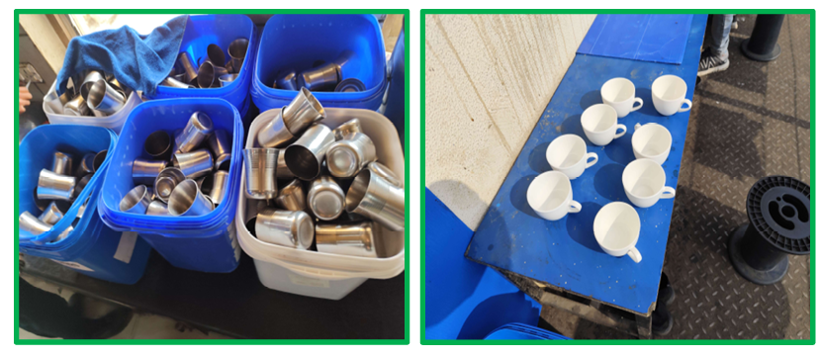
Reuse
C1 – Develop systems that emphasize reuse
Disposable cups replaced by reusable steel cups via a closed-loop collection rack. Staff deposit used cups in a designated rack; housekeeping sanitizes and returns them — zero single-use cup waste.
Use of reusable steel cups instead of plastic cups

Slide 12
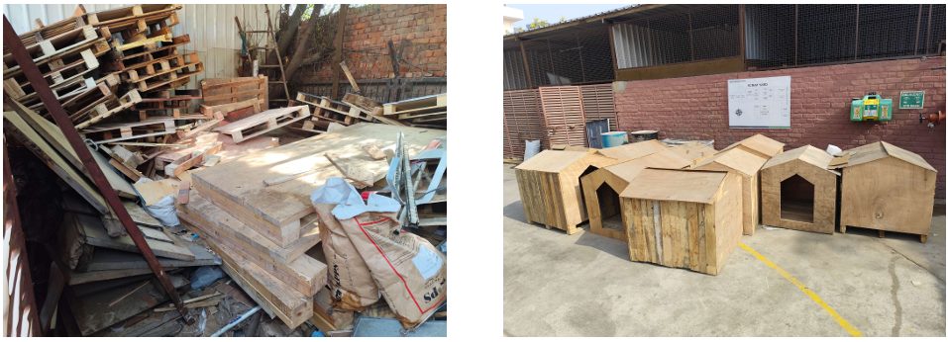
Reuse
C2 – Document pallet and shipping container reuse
All incoming wooden pallets recorded at the gate, inspected, weighed, manually logged, then digitized. Pallets handed to in-house carpenters for upcycling into dog shelters donated to Blessing Foundation NGO.
Dog houses constructed from reused wooden pallets generated from packaging waste, demonstrating the facility’s initiative to upcycle materials and donate them to NGOs for community welfare.

Slide 13
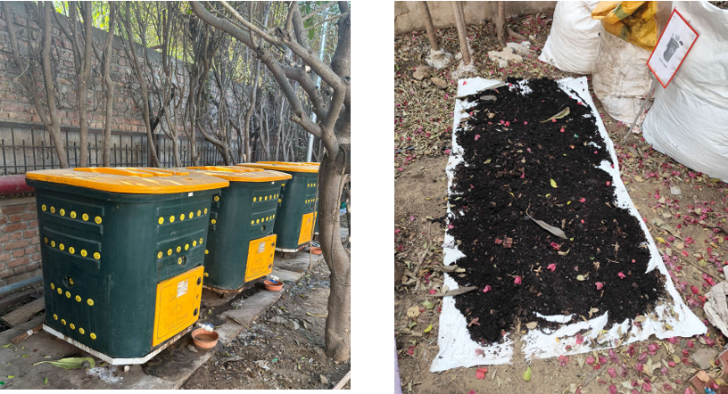
Compost
C3 – Compost food scraps and/or soiled paper on-site
Food scraps, tea leaves, leftovers composted on-site through the OWC. ~21-day aerobic cycle monitored for moisture, aeration, and temperature.
Facility manages on-site composting of food scraps

Slide 14
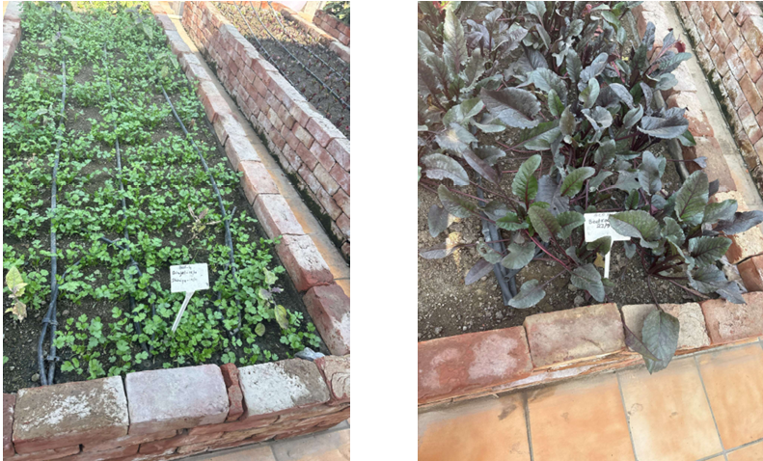
Compost
C7 – Use compost from site for on-site food production
Compost grows: Paalak, Dhaniya, Muli, Methi, Brinjal, Tomato, Broccoli, Cauliflower, Bhindi, Ridge Gourd, Pak Choi, Zucchini, Carrot & more. Harvest used in campus kitchens.
Kitchen garden uses compost produced on site to grow vegetables on PVNA premise

Slide 15
Recycle
C2 – Determine end markets for recycled commodities
Material | End Market / Handler | Processing Method
Soft Plastics | Swayambhu Innovative Solutions Pvt. Ltd. | Sorted → shredded → washed → pelletized → new plastic products
Hard Plastics | GC Industries | Shredded → cleaned → melted → recycled plastic granules
Metals | SS Enterprises | Sorted → de-insulated → cut/shredded → cleaned → melted → refined
Paper/Cardboard | Green Recycling Links (via Saahas) | Shredded → pulped → converted to recycled paper/cardboard
Wood Waste | In-House Carpentry | Pallets upcycled into dog shelters → donated to Blessing Foundation
Food Waste | On-Site OWC (Saahas-supported) | Aerobic composting → compost applied to campus gardens
C1.2 – 100% of materials meet highest and best use

Slide 16
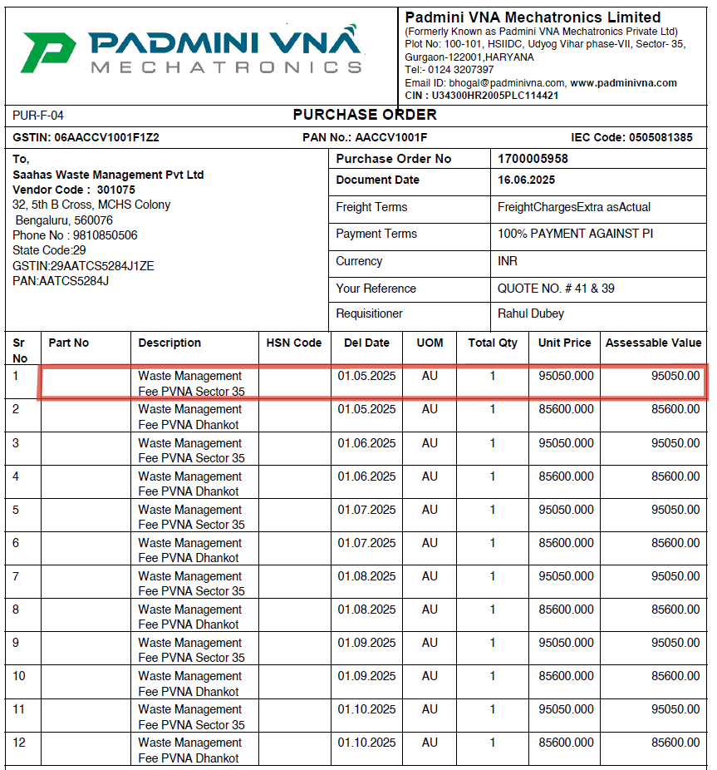
Zero Waste Reporting
ZWR2 – Track financial data for diversion and waste disposal
All waste-related costs and revenues assigned to dedicated budget codes. Invoices and receipts retained for all streams. Periodic reviews and internal audits ensure accuracy.
Purchase order showing Saahas waste management service payment from May 2025.

Slide 17
Diversion
C3- Diversion is 97%-98.9%
Annual average diversion was calculated by dividing the total weight of materials diverted through recycling, reuse, reduce and composting streams by the total weight of materials generated during the reporting year. Waste quantities were compiled from waste hauler reports and internal tracking records to ensure accurate documentation. PVNA has achieved diversion rate of 97.4% demonstrating a strong commitment to zero waste management practices.

Slide 18
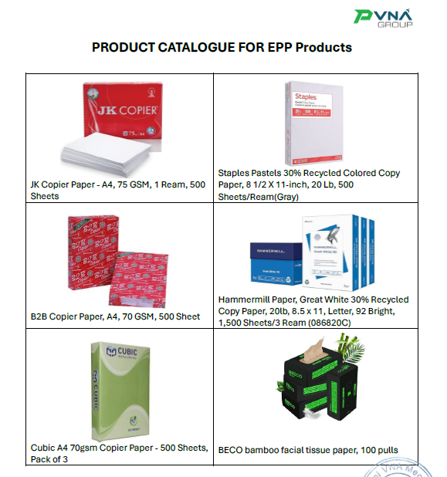
Zero Waste Purchasing
ZWP4 - Identify EPP items in purchasing catalogs
Product catalogue highlights EPP items. Procurement Staff was trained to reference the catalogue before procurement.
Examples: JK Copier Paper 75 GSM, BECO bamboo tissue, Hammermill 30% recycled copy paper.
Product catalogue highlighting environmentally preferred products (EPP) to guide sustainable purchasing decisions within the facility.

Slide 19
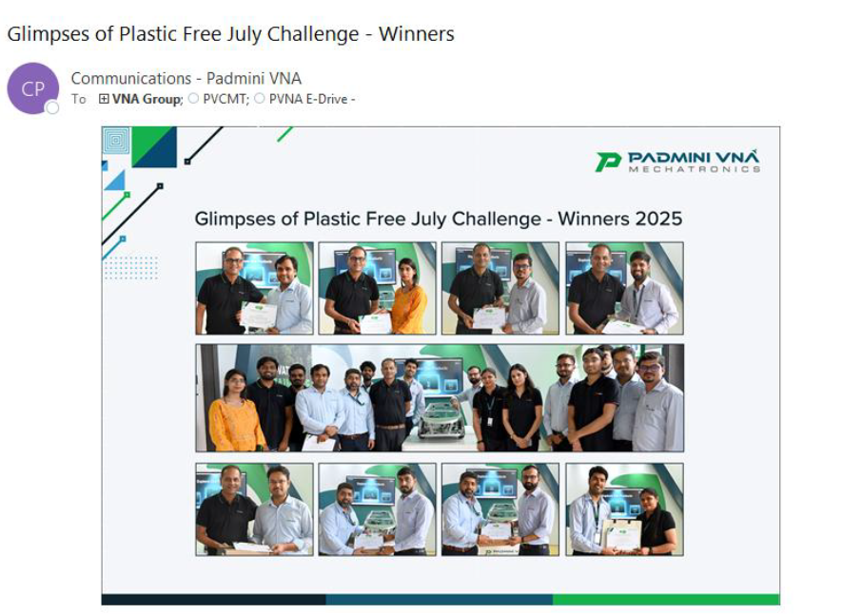
Leadership
C3- Encourage and incentivize employee participation
Employees contributing to zero waste initiatives are recognized through structured reward and recognition programs. Outstanding contributions are acknowledged through internal communication and special recognition during events such as World Environment Day, promoting a culture of sustainability.
Recognition of employees during the Plastic Free July Challenge for their active participation in zero waste and sustainability initiatives.

Slide 20
Leadership
C6- Promote zero waste in the community utilizing upper management personnel
Monthly clean-up drives in the surroundings of the project site. Post-cleanup events include quizzes, guest talks, games, and presentations on global waste problems and daily sustainability practices.
Plastic cleaning drives to promote zero waste in community

Slide 21
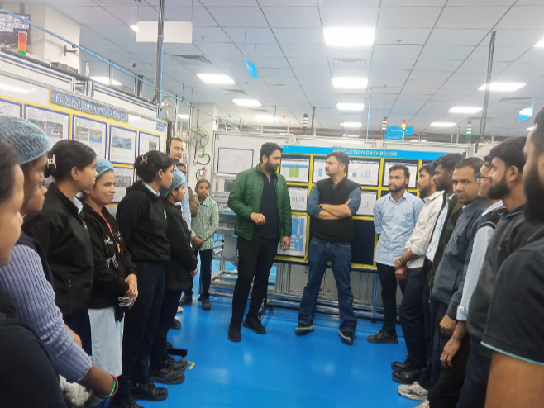
Training
C3- Communicate with employees about zero waste activities quarterly
Quarterly meetings train employees about zero waste practices in campus & recognize employees’ contributions. PVNA also introduce upcoming sustainability initiatives, and encourage employee engagement through open discussions and idea sharing. These sessions provide a platform for employees to ask questions and actively participate in improving the facility’s zero waste program.
Quarterly employee meeting discussing zero waste initiatives, progress updates, and sustainability practices to encourage staff engagement.

Slide 22
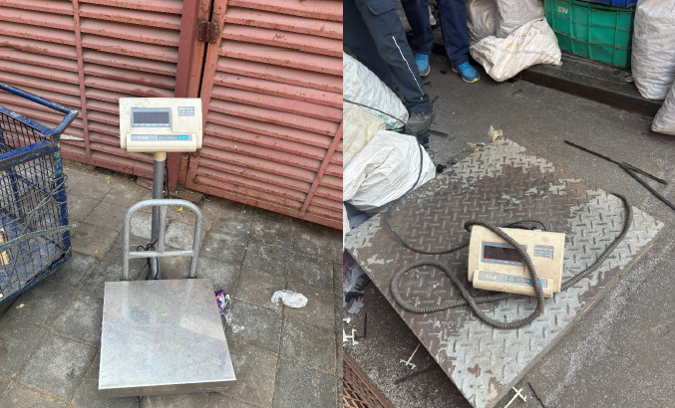
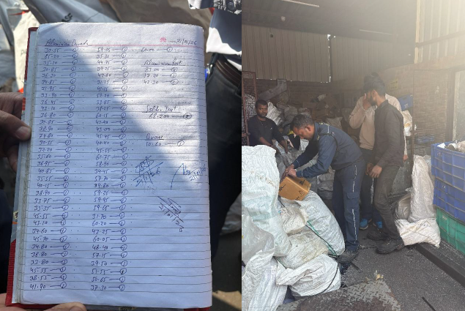
Zero Waste Analysis
C3- Conduct annual physical waste audit
Waste audit was conducted November 2025 at PVNA campus. Dry and wet waste was weighed, recorded, and analyzed. Contamination bins were tracked at central collection and composting areas.
Audit findings were reviewed in upper management board meetings. Three recommendations were implemented: online training modules replacing printed handouts; bin label redesign for better legibility; renegotiation of waste disposal contracts.
The weight of each waste stream is filled in manually on a daily basis. The data is later converted into a digital spreadsheet.

Slide 23
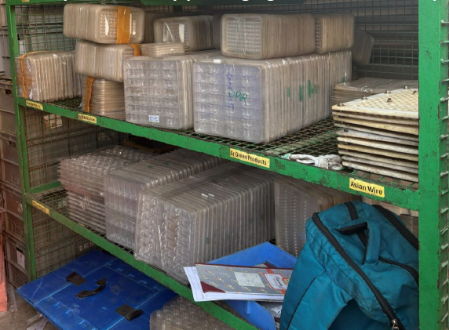
Upstream Management
C1- Work with vendors to eliminate non-recyclable packaging
The facility collaborated with vendors to eliminate non-recyclable foam-based packaging previously used for transporting materials. Foam packaging was replaced with reusable rigid PET trays, which provide the same level of product protection while supporting multiple reuse cycles.
Vendor PET tray packaging stored & returned back to the vendor

Slide 24
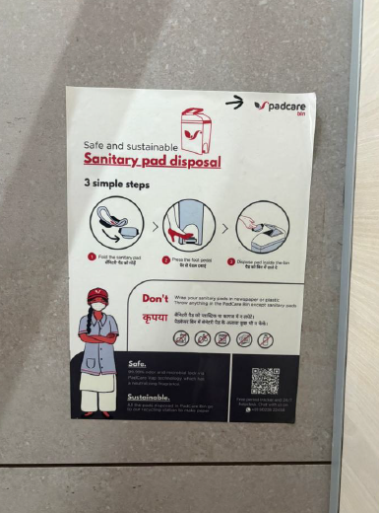
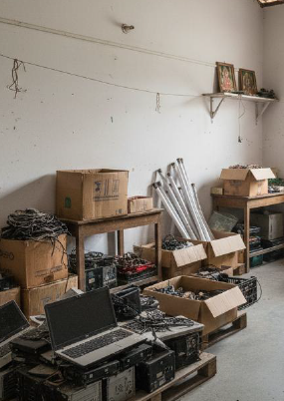
Hazardous Waste Prevention
C5- Collect universal wastes from employees and/or customers
The facility manages universal waste through proper segregation and designated collection systems. Universal waste is collected in clearly marked bins and stored in designated areas to ensure safe handling and hygiene. Sanitary waste is collected through dedicated bins in female washrooms and is regularly serviced by PadCare, whereas Electronic waste is separately collected at local collection points and stored in scrap yard from where it is further sent for recycling to Hind recyclers & salasar recyclers.
Scrap storage area and awareness signage supporting proper segregation and management of universal waste.

Slide 25
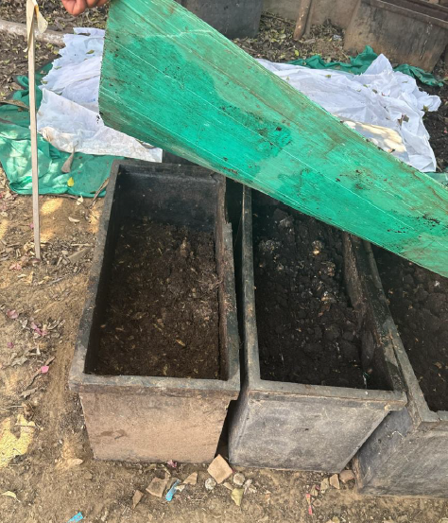
Closed Loop System
C3- Purchase compost from a local source
PVNA's on-site OWC facility composts all wet waste generated on campus into high-quality manure fully eliminating third-party disposal dependency. The resulting compost is directly applied to native trees, turf areas, and campus kitchen terrace gardens. This true closed loop integrates waste generation, processing, and beneficial reuse entirely within the campus boundary.
Organic compostables converted into manure in the on-site composter.

Slide 26
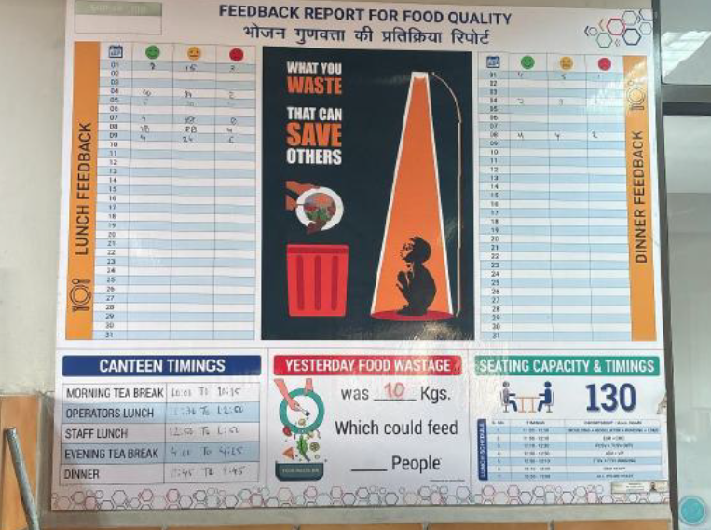
Innovation
C3- Implement innovative waste reduction activity
A daily board near the cafeteria serving counter displays the previous day's food waste quantity, updated every day by canteen staff. Educational posters showing food production effort are displayed in dining areas. Raises portioning awareness among all campus occupants.
Food portioning related educational posters showing how much quantity of food was wasted on the previous day is placed near the serving counters

Slide 27
Credit category: Closed Loop System
Best Practice
The facility processes organic waste through an on-site Organic Waste Composter (OWC), converting wet waste generated on campus into nutrient-rich compost. This supports a closed-loop waste management system by transforming organic waste into a useful resource.
Action Taken
The compost produced is utilized within the campus for landscaping, including native trees, turf areas, and terrace gardens. This practice reduces dependence on external waste disposal, promotes on-site resource recovery, and minimizes environmental impact through efficient reuse of organic waste.
Organic compostables converted into manure in the on-site composter.

Slide 28

Zero waste is not a destination, it is a discipline. Every kilogram diverted, every pallet upcycled, every employee who chooses the right bin is a step that matters. At PVNA, we have shown that with the right systems, the right culture, and the right partnerships, manufacturing and sustainability can coexist and thrive together.
Mr Rahul Dubey, Padmini VNA Mechatronics Ltd.

Slide 29
Zero waste is our mission
true.gbci.org

