Slide 1
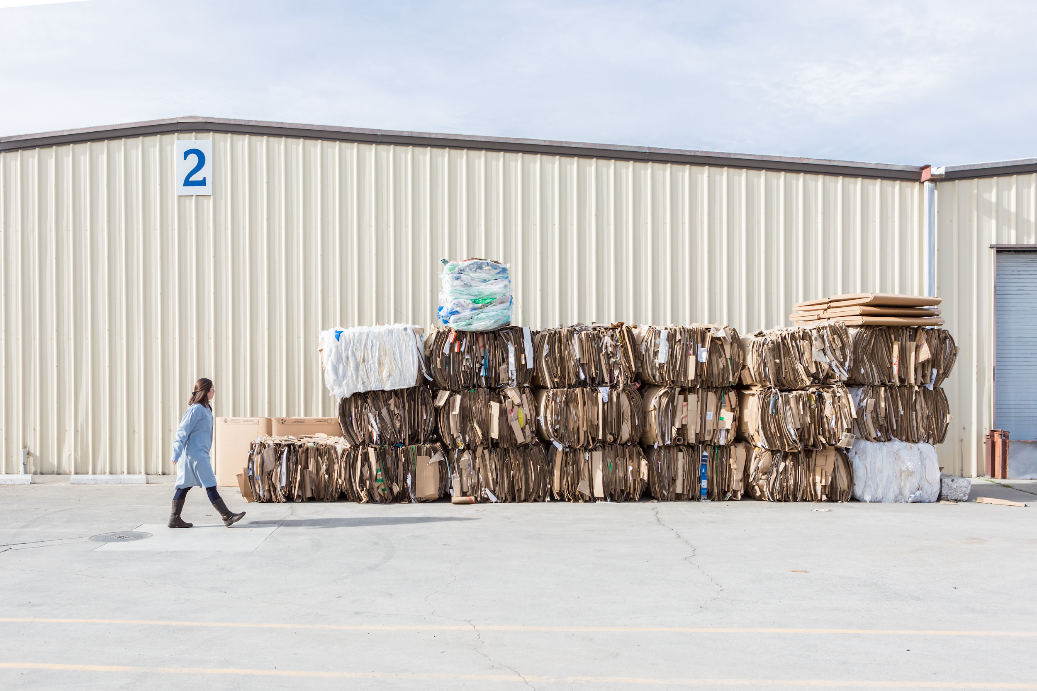

FACILITY CASE STUDY
Colgate Palmolive (M) Sdn. Bhd.
Petaling Jaya, Selangor, Malaysia

Slide 2
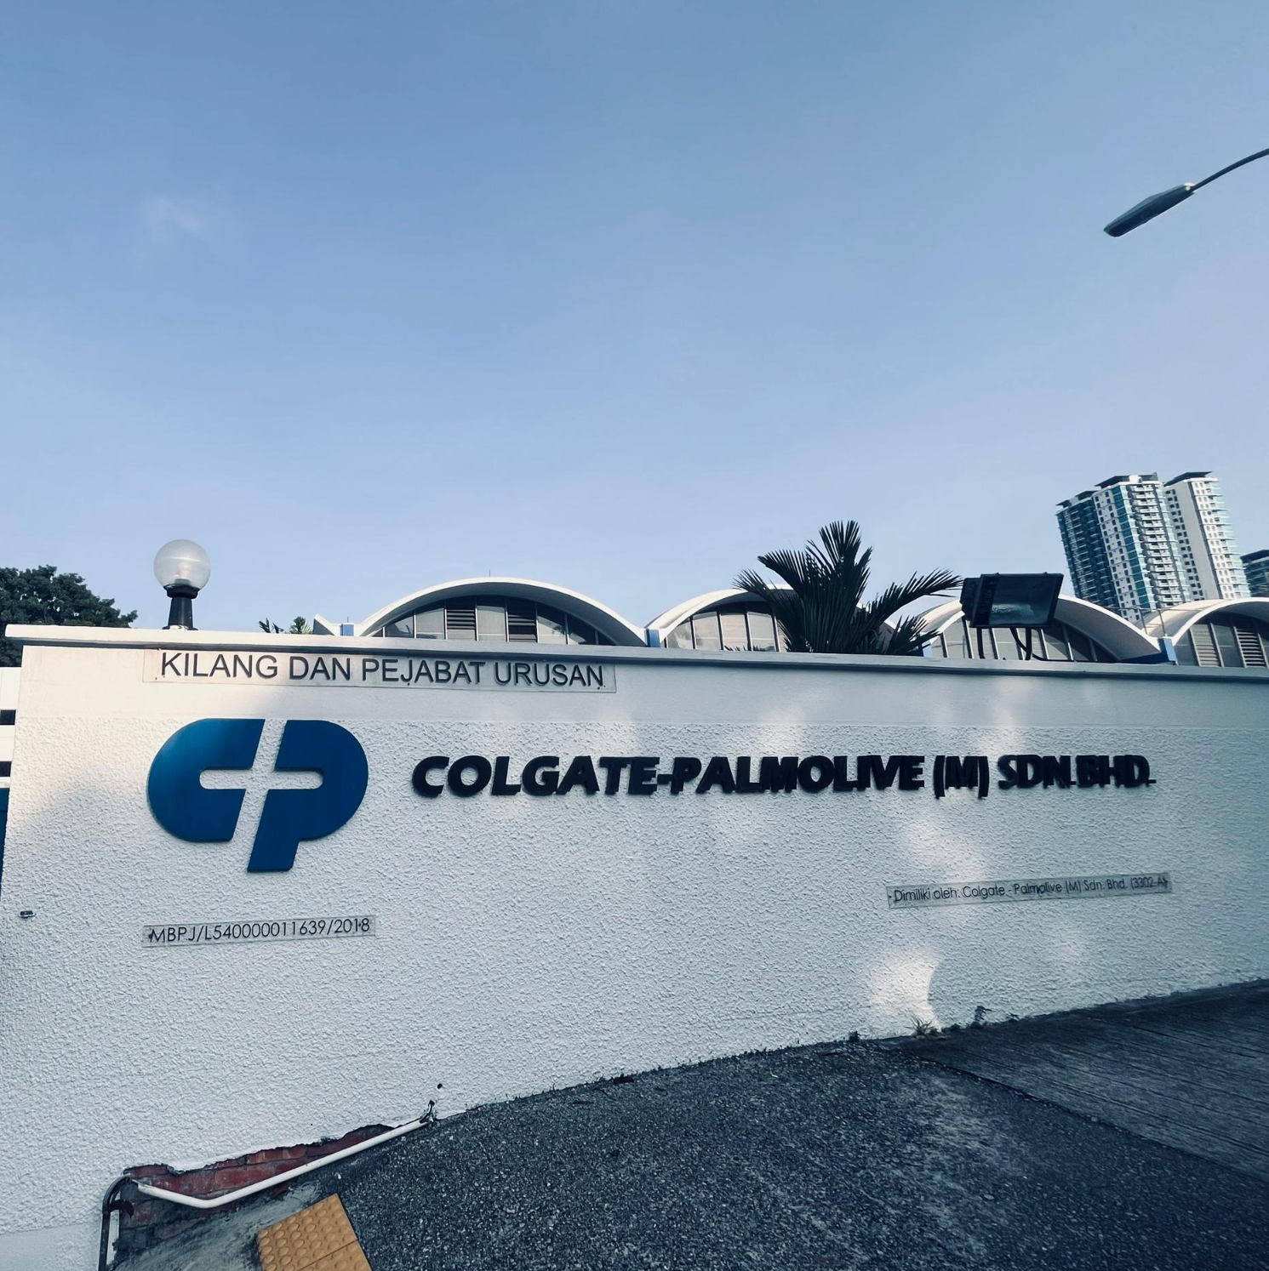
Colgate-Palmolive Petaling Jaya
Colgate-Palmolive (M) Sdn. Bhd
Certification level: Gold
Diversion rate upon certification: 98%
Facility location: Petaling Jaya, selangor Malaysia
Type of facility: Home Care Manufacturing
Notes:
Include a photo of your facility if available. If a photo is unavailable or too granular, the photo box can be deleted.

Slide 3
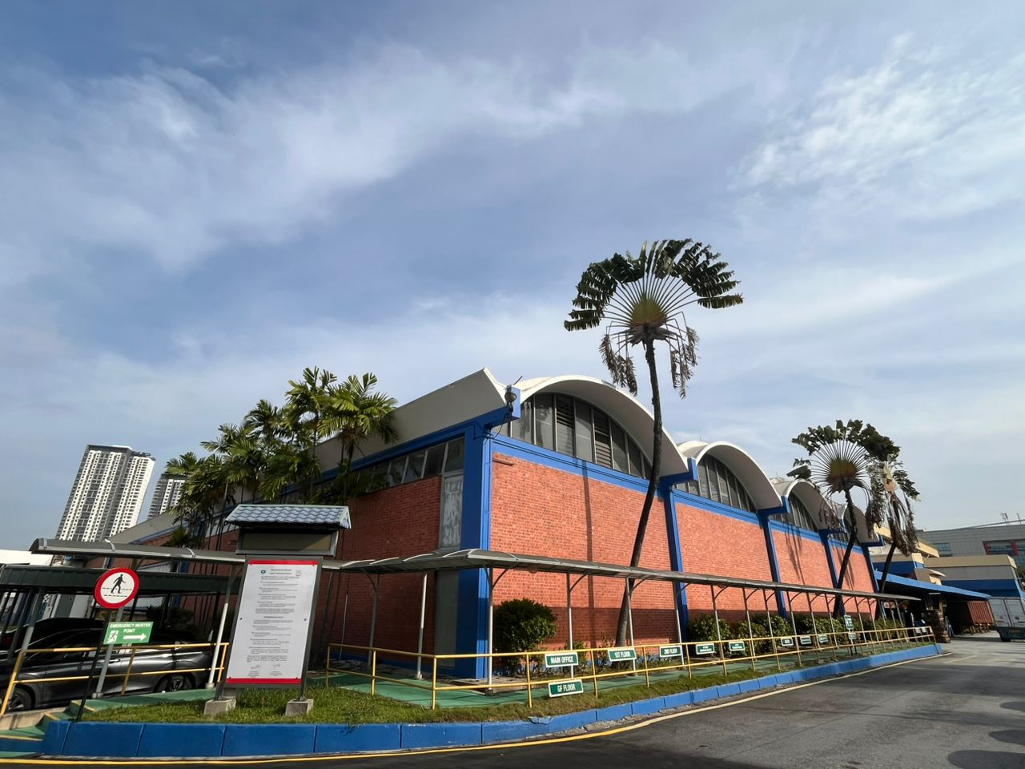
Why zero waste?
CPPJ aims to establish the facility as a leading manufacturer in sustainability by ensuring environmental protection and resource conservation.
A primary motivation is to minimize waste generation at the source through smarter product design, mindful purchasing, and the efficient use of resources.
The organization is committed to managing materials responsibly through recycling, composting, and prioritizing the reuse of equipment and packaging to reduce landfill impact.

Slide 4
Biggest wins
Successfully achieved Gold level for the Petaling Jaya facility with 100% data accuracy verified through digital tracking and documentation.
Maintained over 90% rolling average diversion rate through a rigorous monthly waste inventory and reporting system.
Established circular reuse programs for industrial assets including jumbo bags, plastic trays, and film cores.
Eliminated external disposal of garden and landscaping waste by implementing an on-site organic composting program.

Slide 5
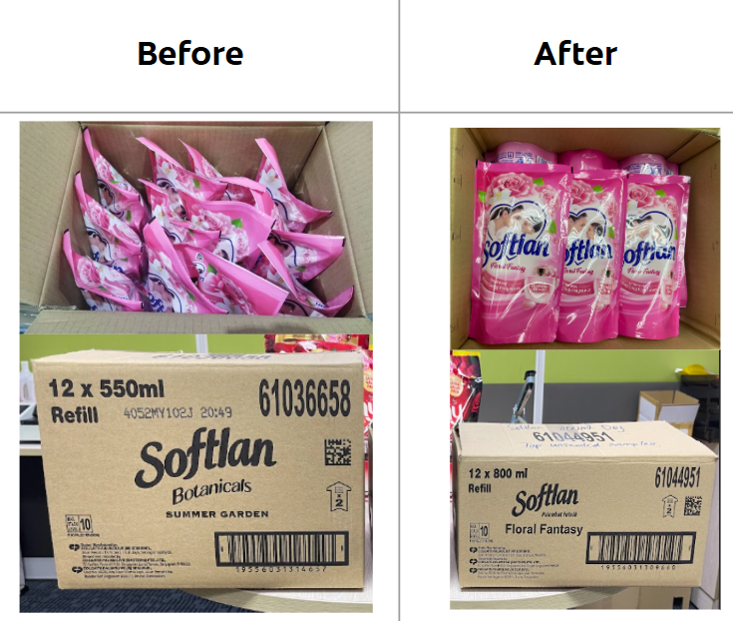
Credit category: Redesign
Credit 3: Design out or eliminate waste
Optimized the outer case specifications for Softlan 800/550ml doypacks to improve material efficiency and structural integrity.
Reduced the shipper’s weight by 9–11% and modified the internal product arrangement from a standing to a lying down position to maximize space utilization.
Increased the Box Compression Test (BCT) value by 25% (from 360 kgf to 450 kgf), significantly enhancing product protection during transit while reducing raw material consumption.
Outer case packaging optimized

Slide 6
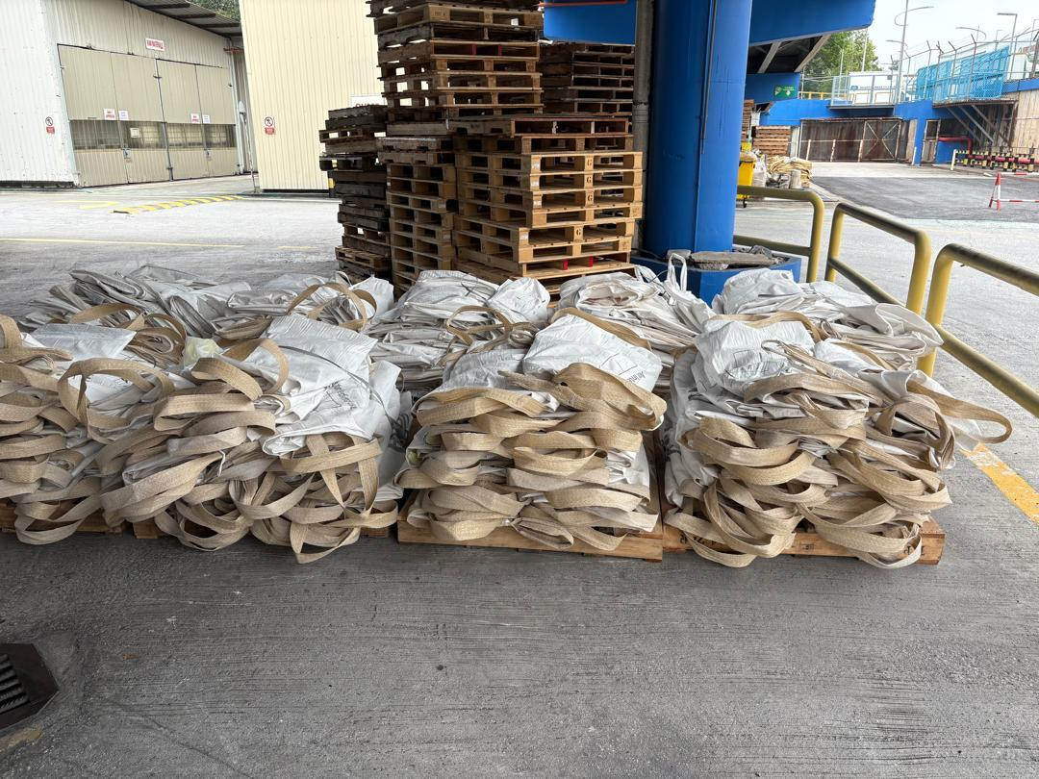
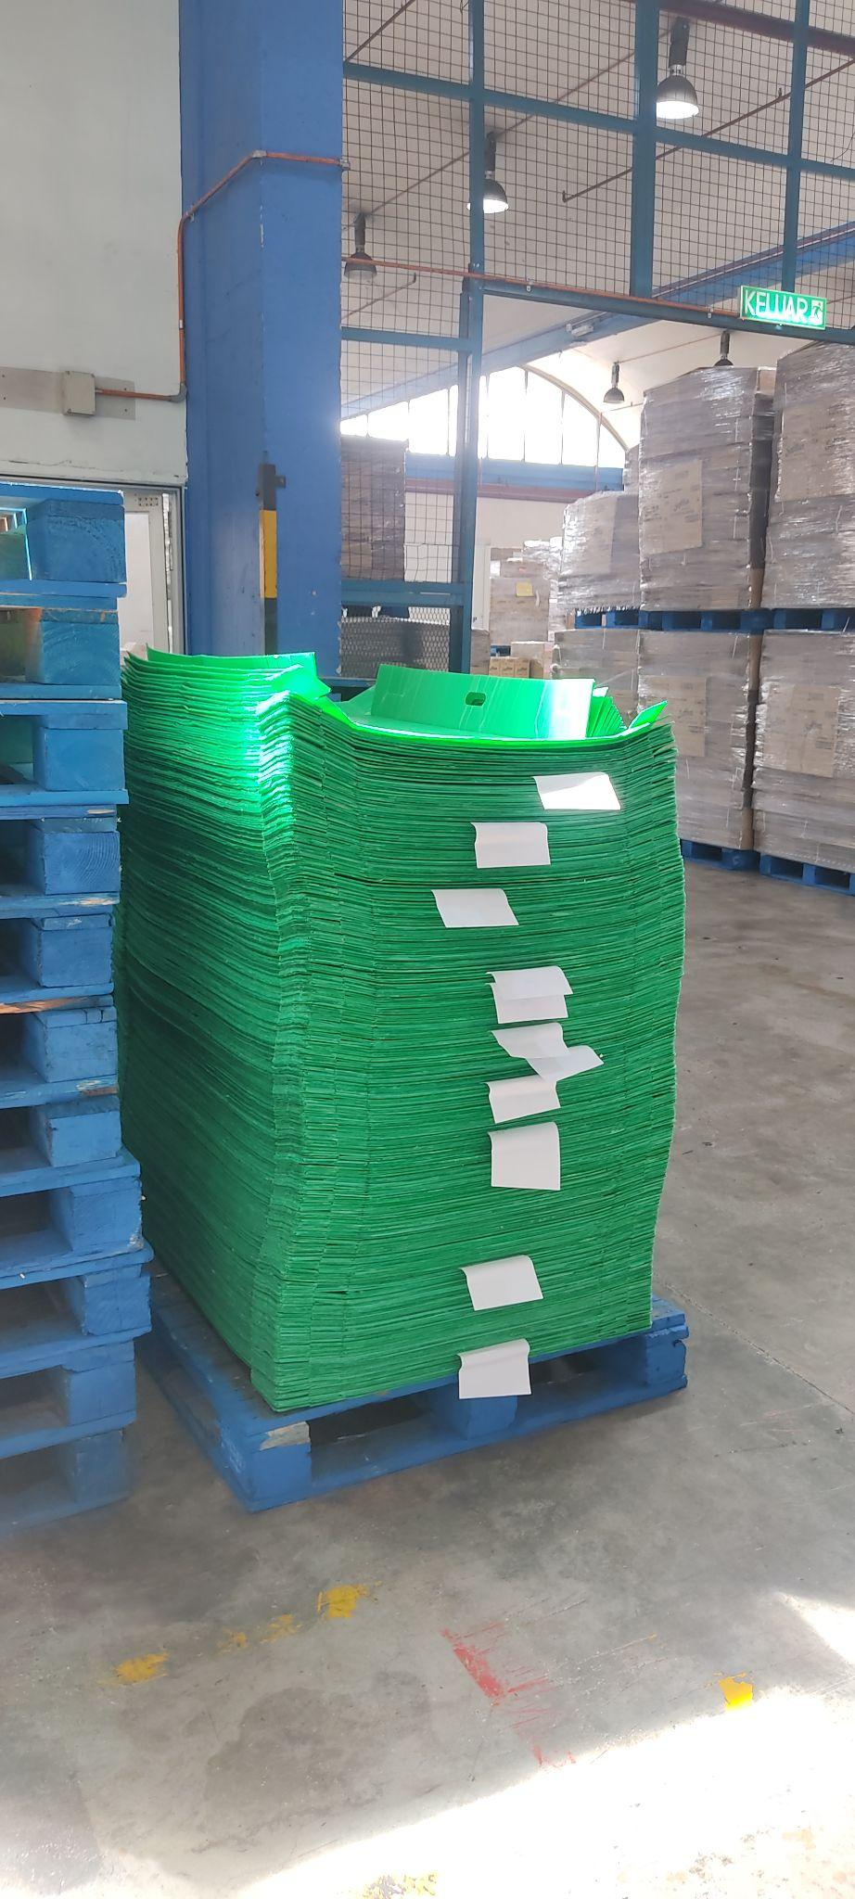
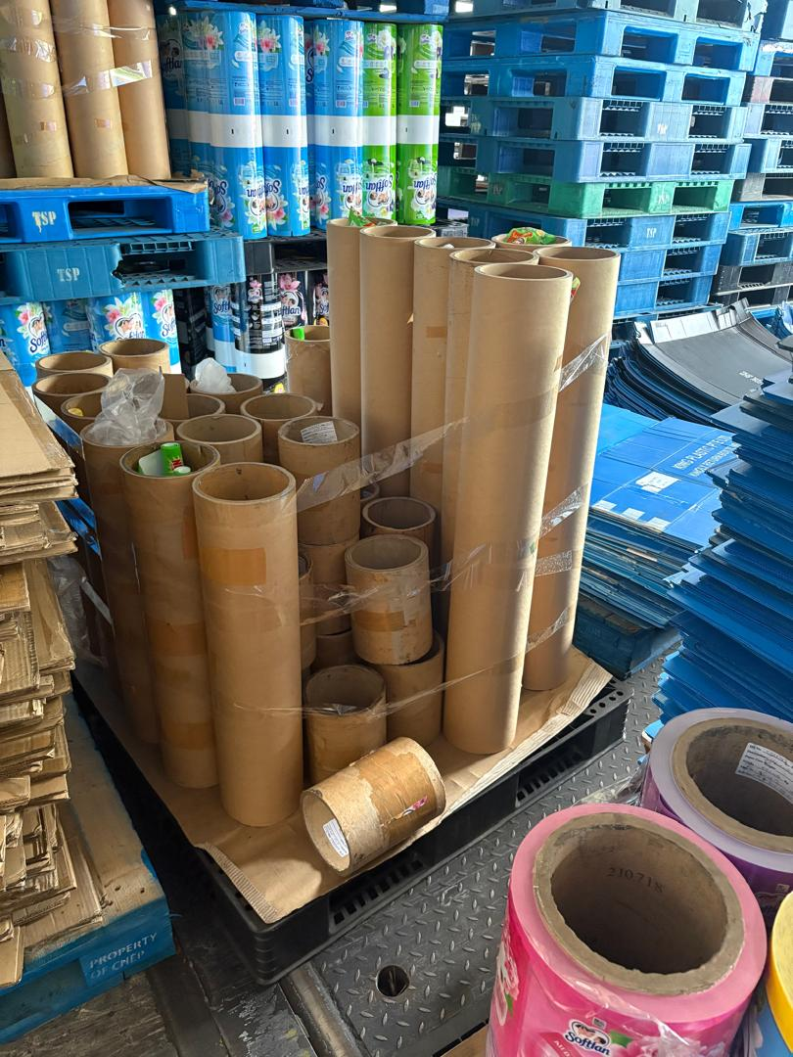
Credit category: Reduce
Credit 2: Closed-Loop Material Tracking
We turn packaging into a sustainable resource by managing a daily return-and-refill system for Jumbo Bags, Plastic Trays, and Film Cores, effectively closing the loop on waste.
Every return is verified via Delivery Advice (DA) documents and logged into our Internal System for 100% data accuracy.
Materials are sent back to suppliers, refilled with new materials, and returned to production.
This prevents returnables from entering the waste stream, ensuring maximum resource efficiency and a true zero-waste facility.
Empty Jumbo Bag, Plastic Tray and Film Cores

Slide 7
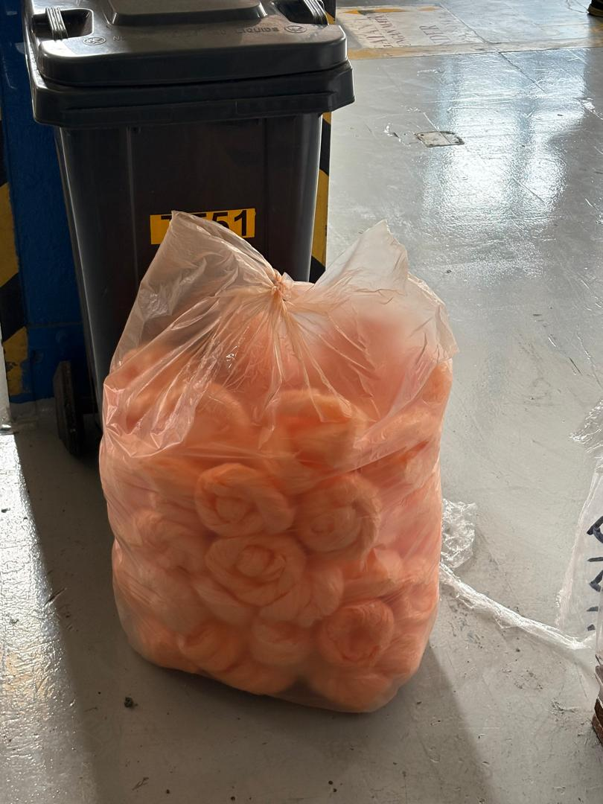
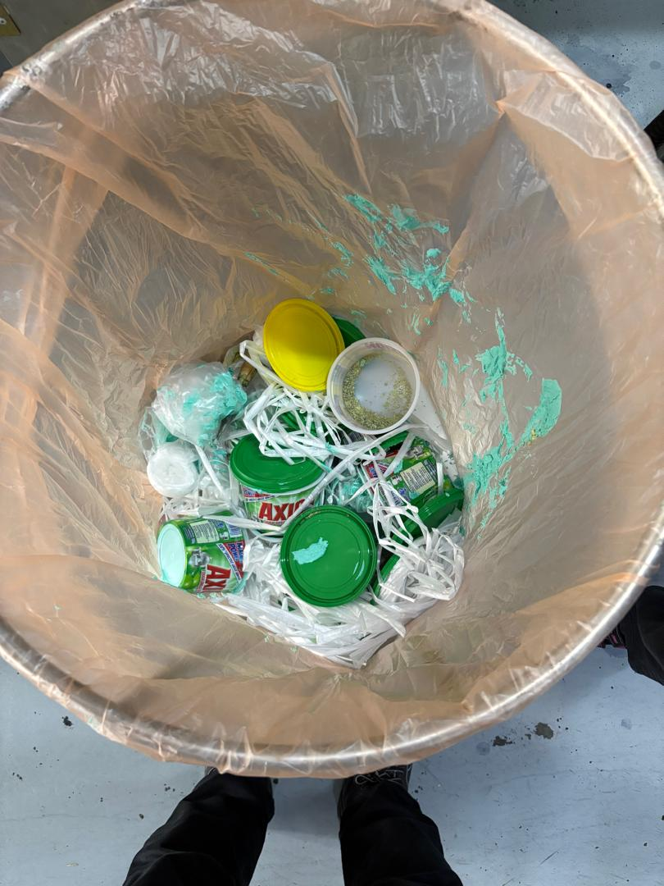
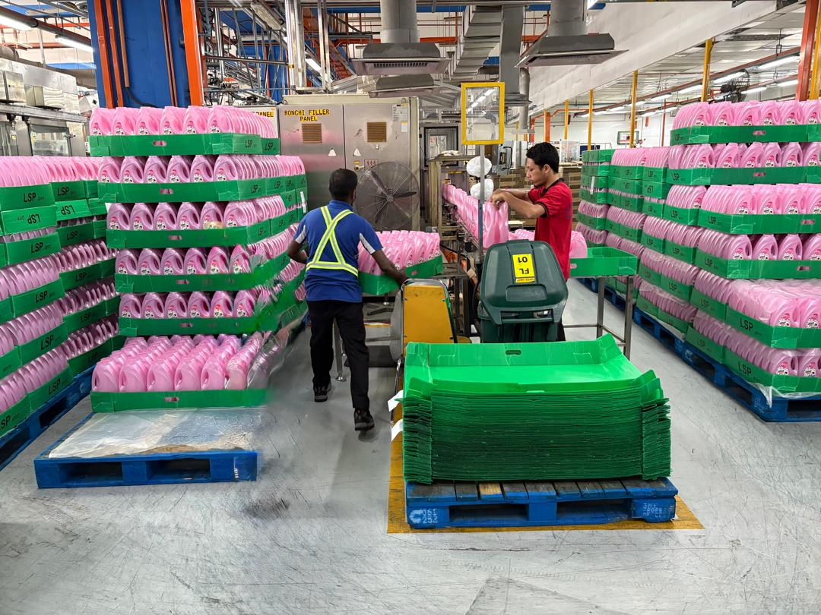
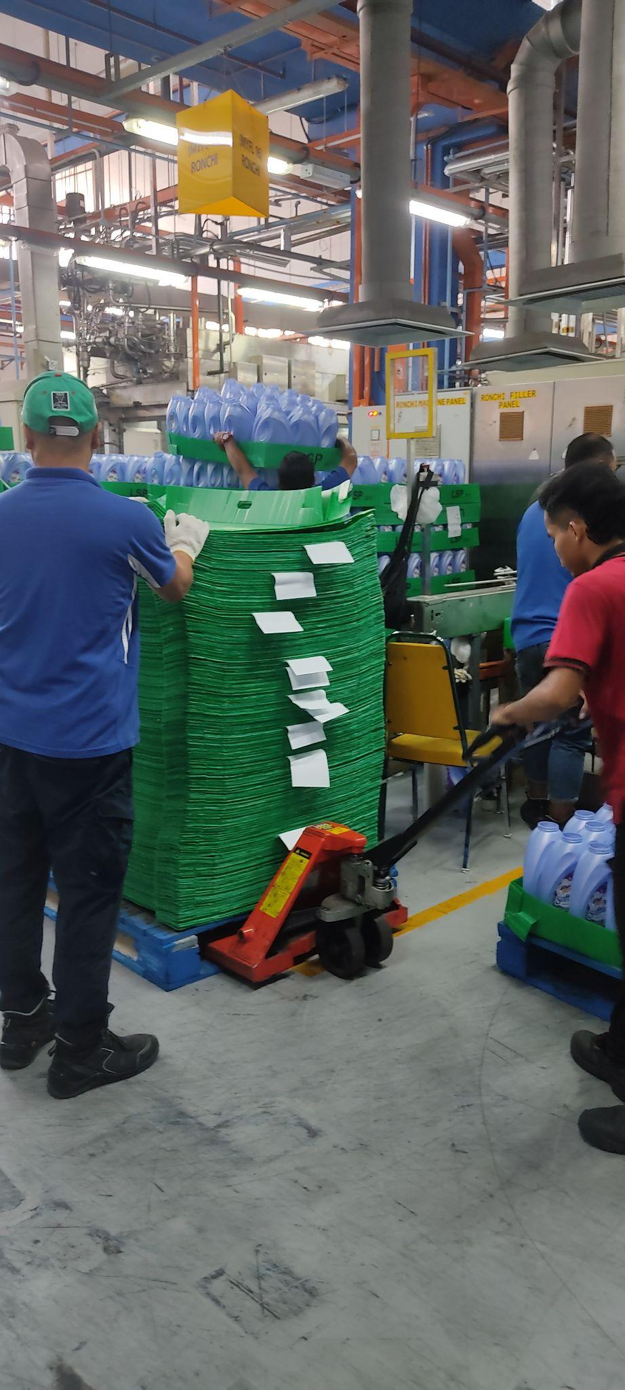
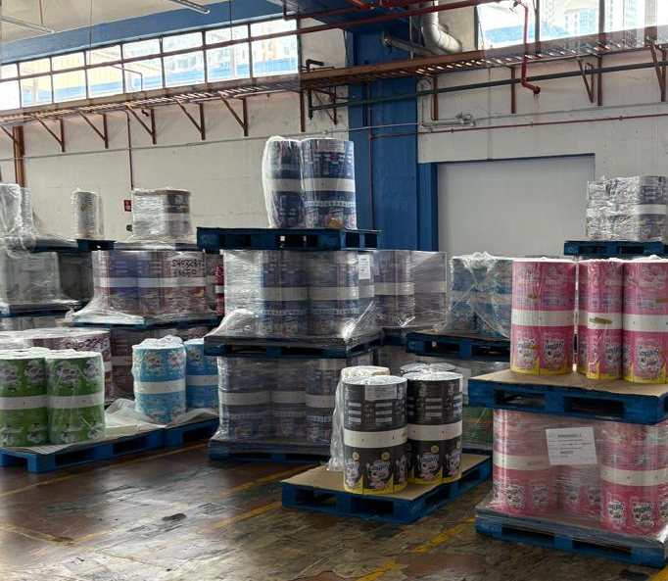
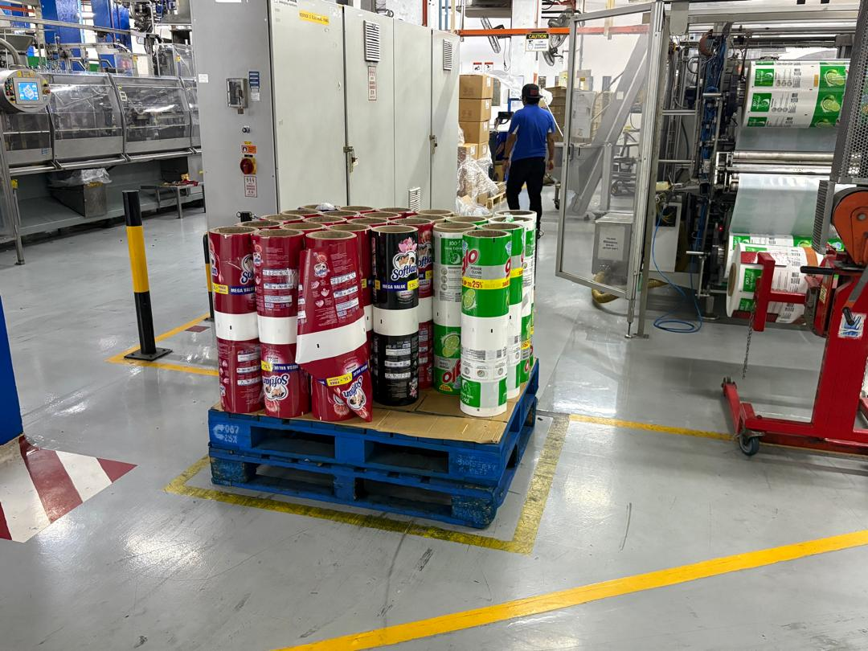
Credit category: Reuse
Credit 1: Develop System That Emphasize Reuse
Our Closed-Loop Packaging System drives environmental sustainability at CPPJ by prioritizing two strategic material streams.
Plastic bags are diverted from waste and reused on-site as trash liners.
Plastic trays and film cores are returned to vendors for refilling and redistribution.
By transforming single-use items into multi-cycle assets, we eliminate unnecessary waste, reduce the need for virgin plastics, and boost operational efficiency.
Reuse on-site or sent to vendor for refilling

Slide 8
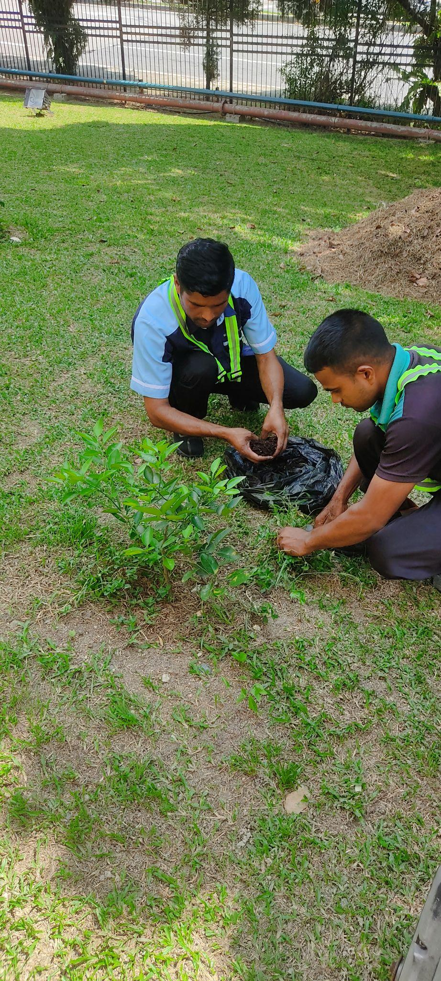
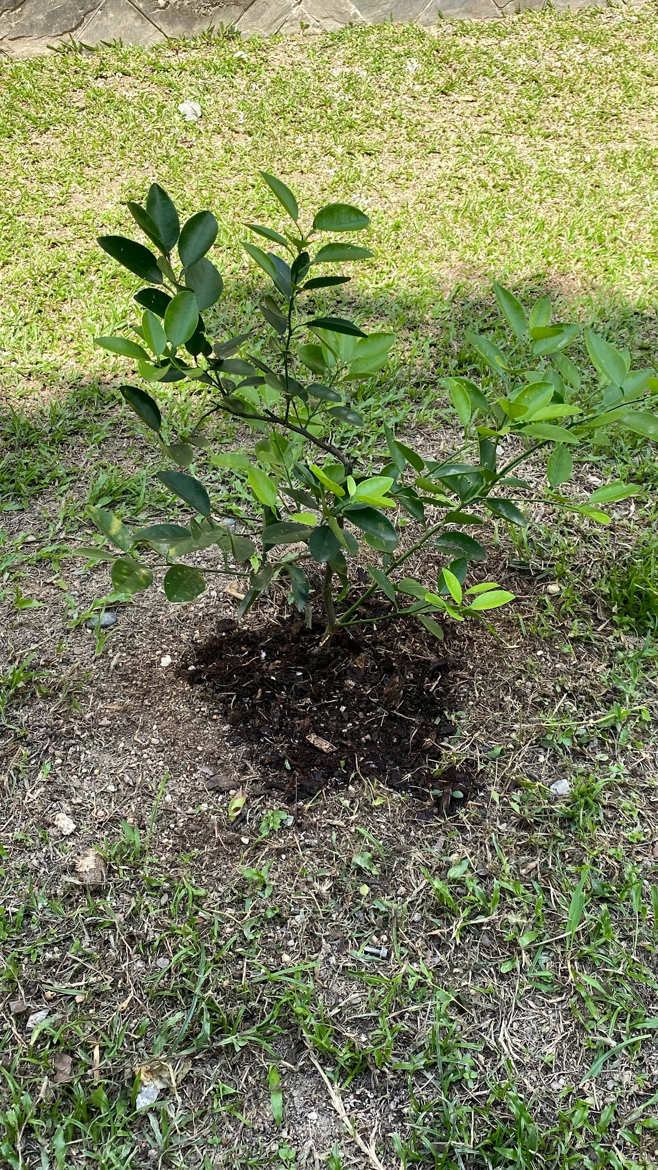
Credit category: Compost (Re-Earth)
Credit 5: Utilize/Reuse Compost or Mulch On-Site
Established an on-site composting program to process garden trimmings and grass clippings into nutrient-rich organic fertilizer.
Implemented a circular waste management cycle where decomposed material is harvested from compost pits for regular application across the site’s greenery and nursery.
Minimized landscaping costs and diverted organic waste from landfills by substituting commercial fertilizers with internally produced mulch and compost.
The compost from the pits is used at plants

Slide 9
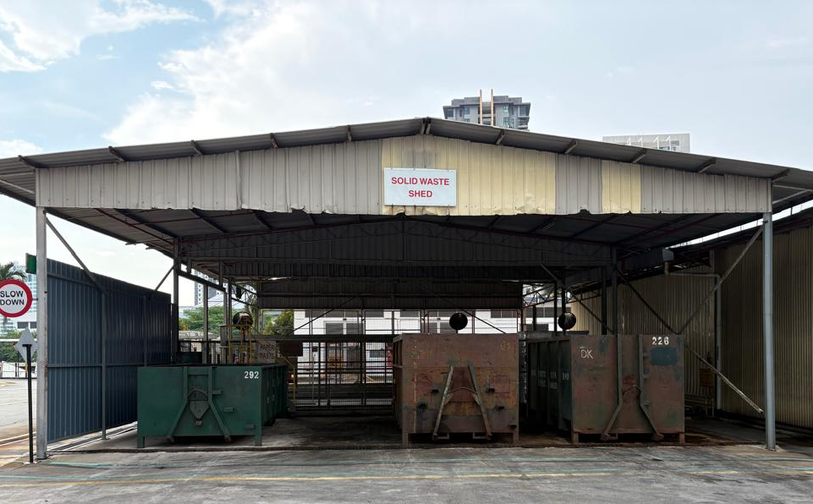
Credit category: Recycle
Credit 2: Document where recyclables are taken
CPPJ ensures the long-term success of its recycling initiatives by focusing on end-market viability. Rather than simply collecting waste, we prioritize the transformation of materials into valuable resources through strategic industrial partnerships.
By feeding the local and national recycling industry, we support a circular economy that remains economically viable.
Our proactive measures turn sorted waste into high-quality feedstock, supporting a sustainable system for modern waste management.
Paper Waste
General Waste
Plastic Waste
Solid Waste Shed

Slide 10
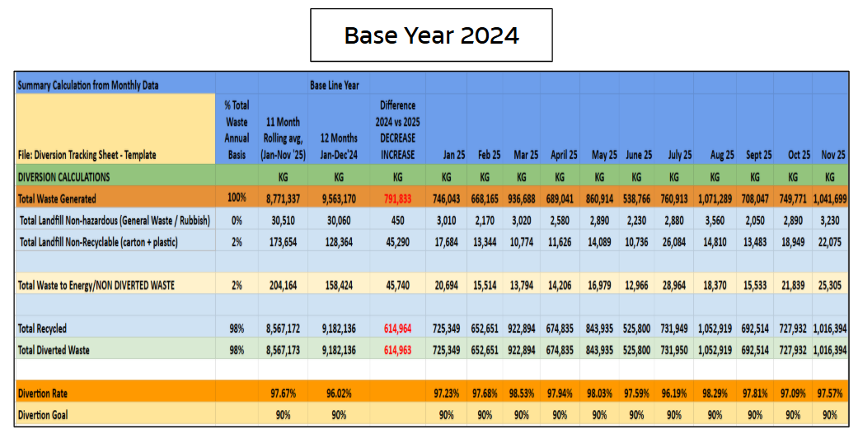
Credit category: Zero Waste Reporting
Credit 1: Document 90% diversion or better
CPPJ maintains a monthly waste inventory report detailing specific categories, units of measure, and precise weights for all output.
All diverted materials (reused/recycled) are sold to authorized vendors, with every transaction validated by official records and invoices.
Performance is logged monthly in the CPPJ Emission Tracking database, supplemented by a localized spreadsheet for real-time monitoring and follow-up.
Achieved a 96.02% rolling average diversion rate.
Base year 2024 rolling average 96.02% diversion rate

Slide 11
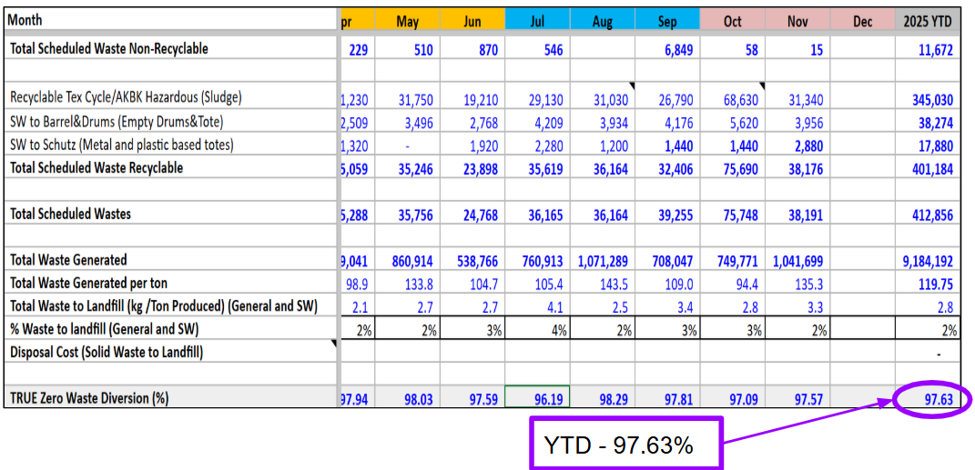
Credit category: Diversion (Min. 90%)
Credit 3: Diversion is 97% – 98.9%
A significant achievement in waste management focusing on the high-rate diversion of materials from landfills and incineration.
The CPPJ plant maintains an effective strategy for minimizing environmental impact through a comprehensive data collection process.
Diversion performance is validated by a longitudinal study of data spanning from 2023 to 2025, demonstrating consistent ongoing progress.
Diversion tracking sheet

Slide 12
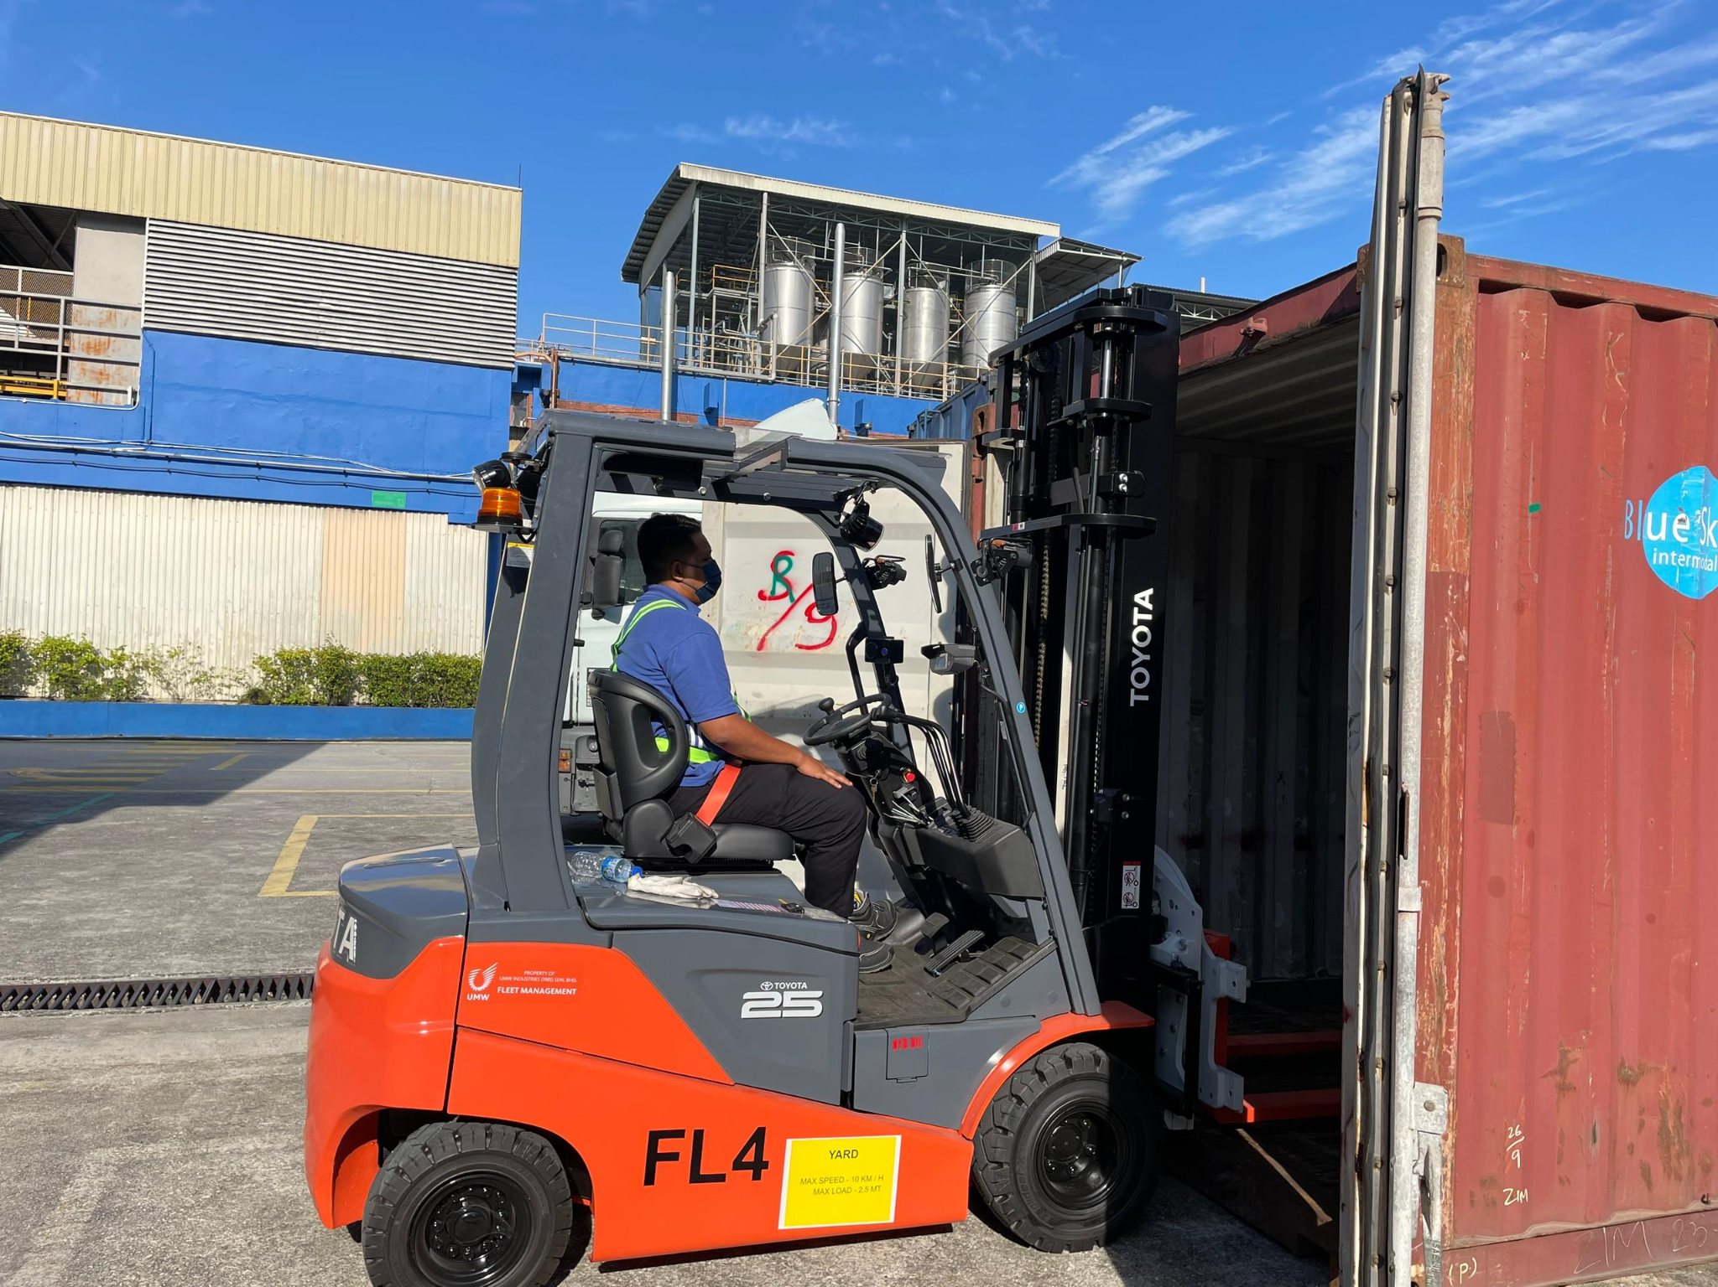
Credit category: Zero Waste Purchasing
Credit 7.2: Other EPP practices
Leasing high-value equipment like forklifts allows for seamless return to the manufacturer or resale, avoiding the disposal burdens of direct ownership.
"Equipment Return Provisions" within lease agreements ensure assets are managed responsibly at the end of their lifecycle.
This approach minimizes facility waste by shifting the responsibility for long-term equipment disposal back to the supplier.
Leasing forklift used on-site

Slide 13
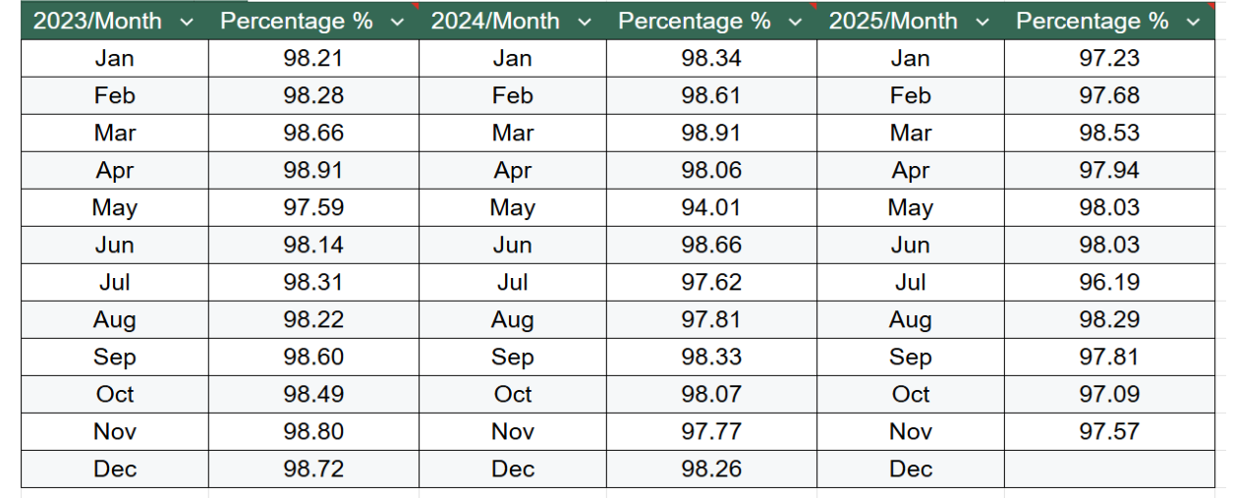
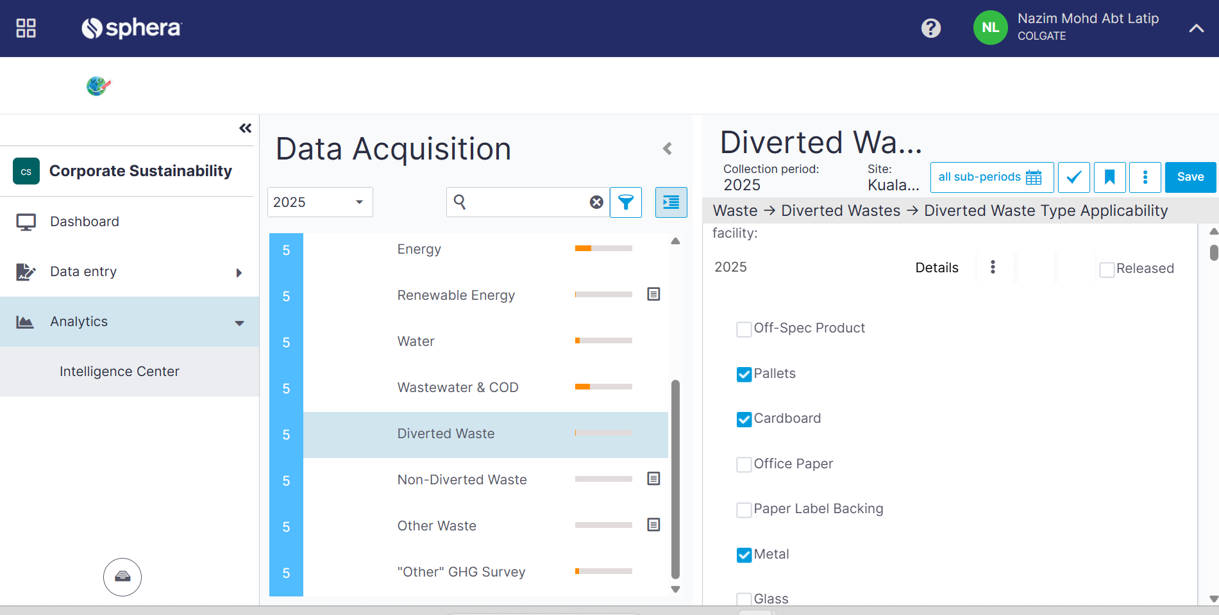
Credit category: Leadership
Credit 2: Upper management reviews Zero Waste reports
The Green Team drives the TRUE program by aligning management, staff, contractors, and suppliers toward a shared Zero Waste certification goal.
We ensure accountability through monthly diversion reviews and quarterly senior audits, with transparent data tracking via Sphera and Google Sheets.
Regular management updates and site-level feedback allow us to refine strategies and maintain high engagement across the entire operation.
EHS report waste diversion to Colgate Global EHS center monthly.

Slide 14
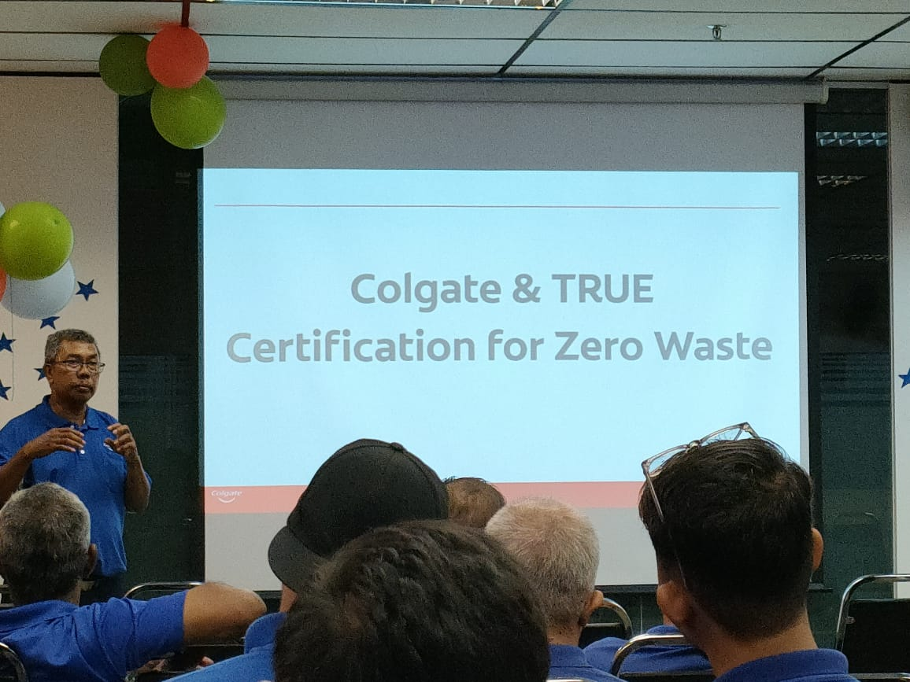
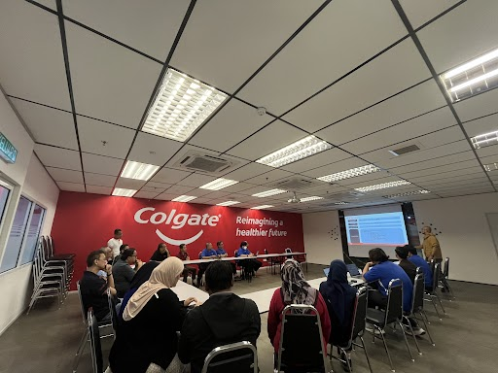
Credit category: Training
Credit 3: Quarterly communicate with associates about Zero Waste
Monthly BGTM and EHS meetings provide continuous waste-reduction updates for all staff and management.
EHS Week offers intensive, in-depth education on minimizing environmental impact and landfill waste.
The mix of frequent check-ins and an annual deep-dive ensures the Zero Waste message remains a consistent priority.
Communicating True Zero Waste to S&C, Non S&C (Associates Representative) & Management Team

Slide 15
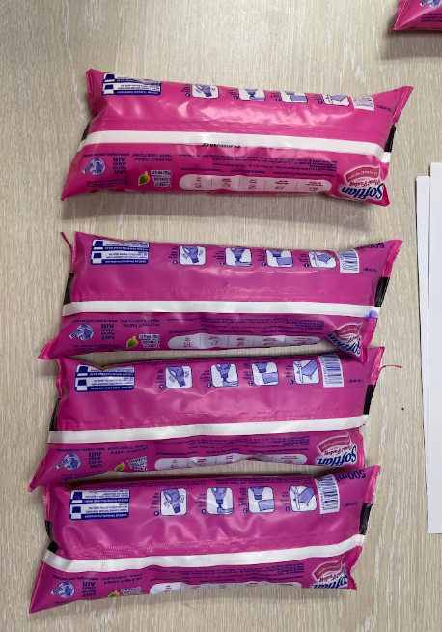
Credit category: Upstream Management
Credit 1: Suppliers eliminate non‐recyclable packaging
Qualified a fully recyclable mono-PE packaging for Softlan ESP 500ml, directly supporting our goal to eliminate plastic waste.
Partnered with vendors to conduct in-house seal integrity and burst pressure tests, ensuring the new material meets all supply chain durability standards.
Proven durability reduced product rejections and packaging damage, effectively eliminating both material and liquid waste in a single initiative.
Leakages
Control
Sample 1
Sample 2
Sample 3
To repeat test after center seal condition is restored.

Slide 16
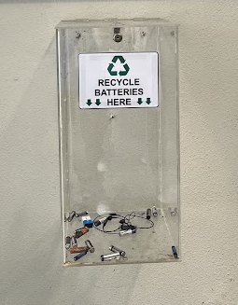
Credit category: Hazardous Waste Prevention
Credit 5: Collect From Employees and Customers
We empower employees to dispose of household waste responsibly by providing on-site infrastructure they may lack at home.
Dedicated collection bins are now available for hazardous "Universal Waste," specifically targeting batteries and electronic waste.
We have launched site-wide communications to ensure all staff are aware of these disposal opportunities and how to use them correctly.
Recycled battery bin at Commercial Building

Slide 17
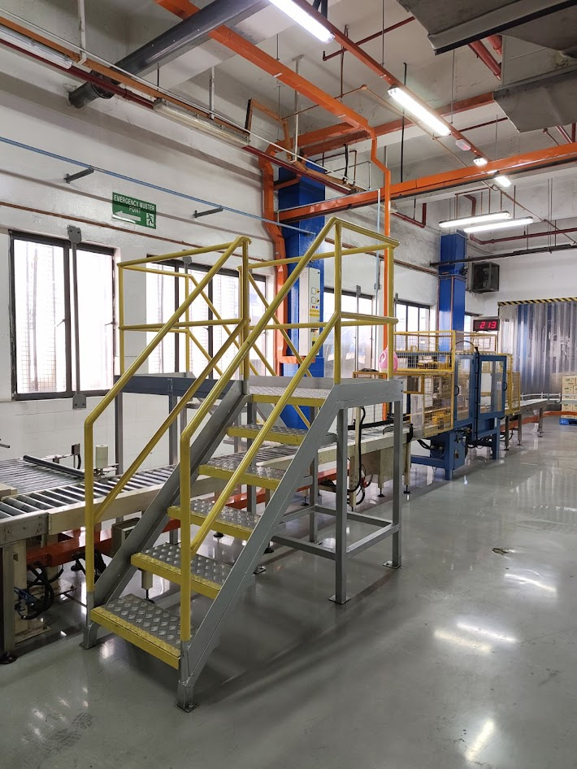
Credit category: Innovation
Credit 1: Upcycle non‐traditional recyclable materials
Repurposed surplus LMDO square hollow bars (previously considered scrap) to fabricate custom crossover stairs for the production line.
Minimized environmental impact by diverting metal from the waste stream and eliminating the carbon footprint associated with manufacturing and transporting new equipment.
Achieved significant savings by avoiding new capital expenditures while enhancing on-site safety through internal resourcefulness.
Crossover stair

Slide 18

“By 2025, we aim to achieve 100% TRUE certification for our global operations, including manufacturing sites, technology centers, strategic offices, and owned warehouses. With enthusiastic teams, collaborative partners and this comprehensive approach to waste reduction, we’re confident we can make it happen.”
Ann Tracy, Chief Sustainability Officer

Slide 19
Zero waste is our mission
true.gbci.org

